Slide 1


SCAM 2021
Fundamental
Analysis:
Cadila Healthcare
Finsearch

Slide 2

INTRODUCTION
Fundamental Analysis involves examining the economic, financial and other qualitative and quantitative factors related to a security in order to determine its intrinsic value.
It attempts to study everything that can affect the security's value, including macroeconomic factors (like the overall economy and industry conditions) and individually specific factors (like the financial condition and management of companies)..
Fundamental analysis, which is also known as quantitative analysis, involves delving into a company’s financial statements such as profit and loss account and balance sheet.
Fundamental analysis is the examination of the underlying forces that affect the wellbeing of the economy, industry groups, and companies

Slide 3
FUNDAMENTALS:
QUANTITATIVE AND QUALITATIVE
QUANTITATIVE:
QUALITATIVE:
Capable of being measured or expressed in numerical terms.
Related to or based on the quality or character of something, often as opposed to its size or quantity.
Quantitative fundamentals are numeric, measurable characteristics about a business. It’s easy to see how the biggest source of quantitative data is the financial statements. You can measure revenue, profit, assets and more with great precision.
Turning to qualitative fundamentals, these are the less tangible factors surrounding a business - things such as the quality of a company’s board members and key executives, its brand-name recognition, patents or proprietary technology.

Slide 4
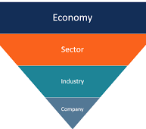
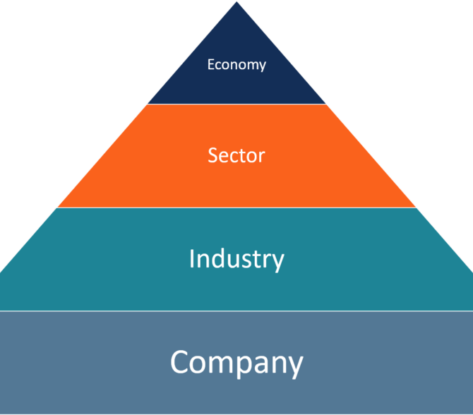
Approach 1
TOP TO DOWN
Approach 2
BOTTOMS UP

Slide 5
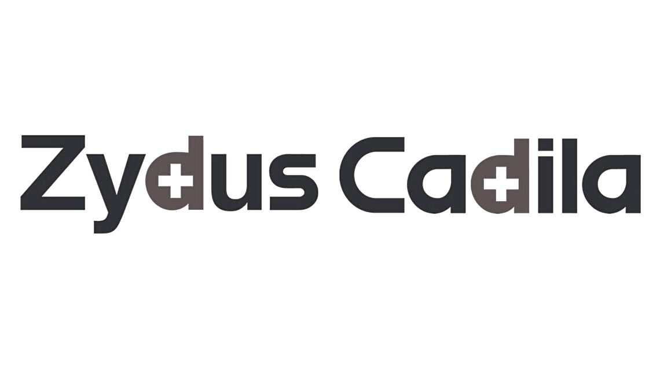
FA: CADILA HEALTHCARE
Let us start with the fundamental analysis of Zydus Cadila

Slide 6

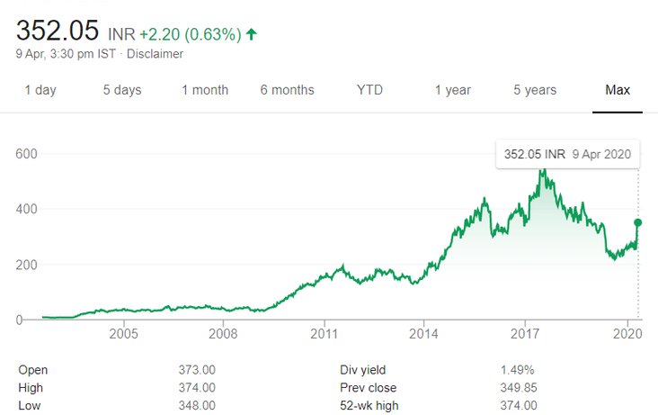

INTRO
Cadila Healthcare is also known as Zydus Cadila is an Indian pharmaceutical company based out of Ahmedabad in Gujarat. Zydus Cadila is a fully integrated global healthcare provider and has strong capabilities across the spectrum of the pharmaceutical value chain. In 1995, the group was restructured and thus Cadila Healthcare was formed under the aegis of the Zydus group.

Slide 7
Parameters
THAT WE'RE USING
Business Model and Management
Economic moat
& Ratios
Future Prospects

Slide 8
RATIOS
GROWTH (5/5)
PROFITABILITY (3/5)
The Operating Income and Net income have also seen 14.4% and 15.5% CAGR change respectively over the same period
The gross margin has almost flattened over the years. However, the margins are likely to remain flattened in the future without any significant improvement.
CASH FLOW (4/5)
EFFICIENCY (2/5)
The net income margin has declined and the Cap-Ex as a percentage of sales has reduced over the recent years.
Overall the business efficiency has declined over the years as the company expanded into new formulations and across new geographies.

Slide 9
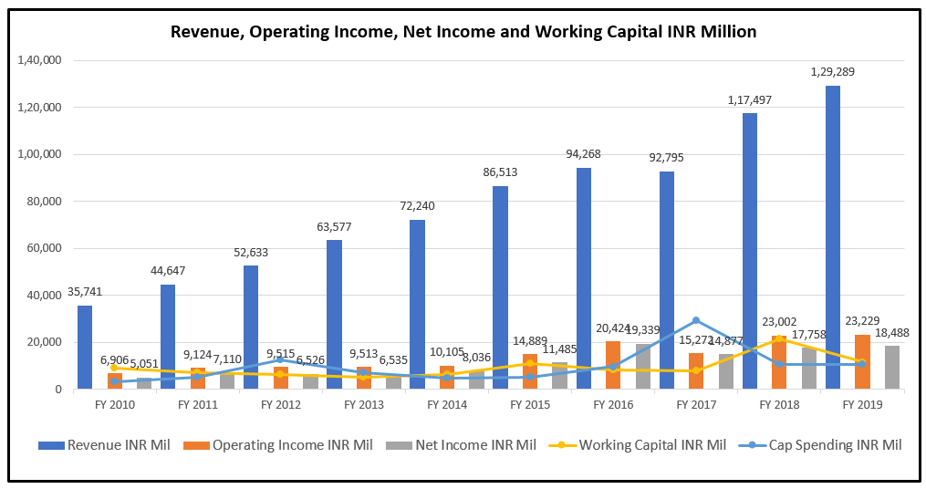
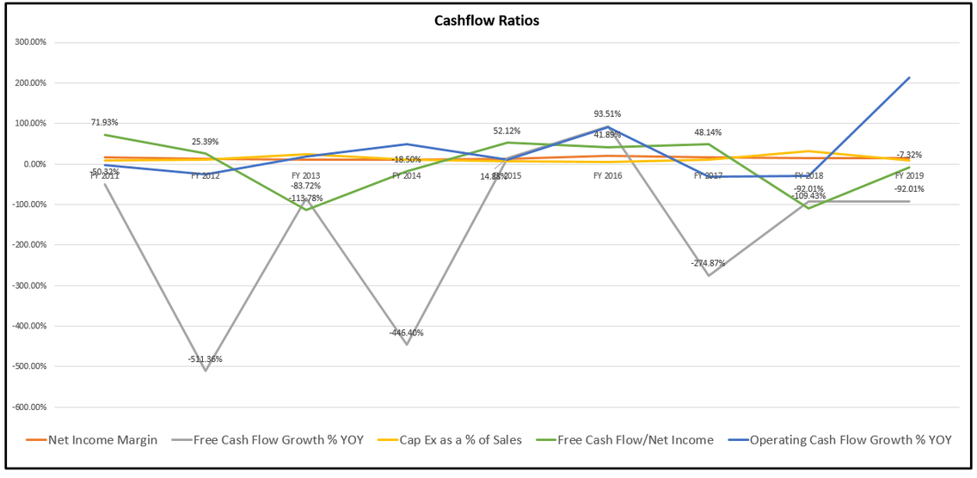
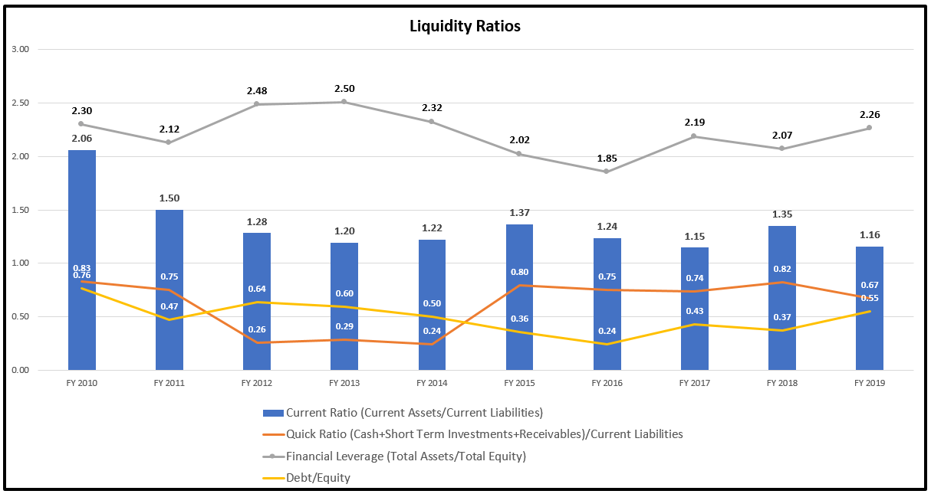
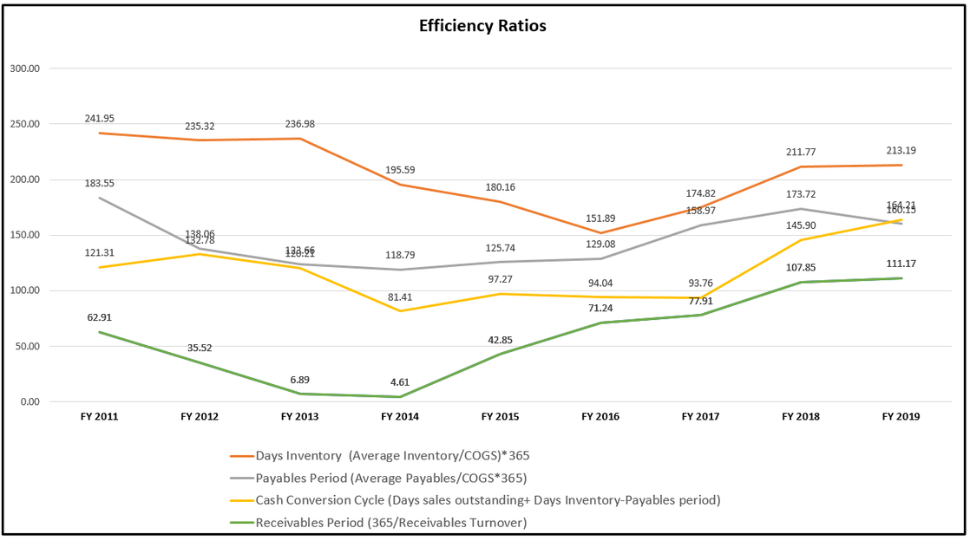

Slide 10
FA
(4/5)
ECONOMIC MOAT
The company operates in the pharmaceutical industry where market dominance is achieved through R&D, regulatory approvals, scale and distribution network. Cadila Healthcare is the 4th largest pharmaceutical company in India and has 65+ years of market presence. The company has 37+ manufacturing facilities across the world and is amongst the top 3 players in Oncology, Respiratory Pain and Gynecology. Zydus is also one of the fastest-growing pharmaceutical companies in the US with $ 895 million revenues and growing at CAGR of around 18%.

Slide 11
SURVEY RESULTS
(5/5)
BUSINESS MODEL AND MANAGEMENT
The business model of the company is such that it operates roughly through 6 verticals namely Global Gx Business, Branded Business, Specialty products, NCE and NBEs, Animal Health and Wellness and Partnerships. In global Gx business, the company has 15+ years of market presence in the US and 4th Largest pharmaceutical company by prescriptions. It also has a strong presence in France and Spain with a focus on increasing market coverage. In speciality products the company has 20+ biosimilar products and is the second company in the world to develop Typhoid conjugate vaccine.

Slide 12
Future Prospects (3/5)
APPROACH
The company is in the process of developing the Covid-19 drug but any comments cannot be made at this point in time about its success commercially. The company recently announced the success of pre-clinical development of its vaccine and received the Drug Controller General of India’s (DCGI’s) permission to initiate human trials.
In the biosimilar business, the company has over 18 products are under development for India and European markets. They have also filed NDA for Sarogltazar Mg with the Drug Controller General of India (DCGI) for Non-alcoholic Steatohepatitis (NASH).
Overall the company has seen a slight deterioration of its financial position and the growth is only on the revenue side. The bottom line and asset turnover are expected to remain flat without any significant improvement.

Slide 13
TECHNICAL ANALYSIS
Technical analysis is a trading method used to identify trading opportunities by analyzing statistical trends gathered from trading activity, such as price movement and volume.
Technical analysts use previous activities and price movements to predict future prices.
Different chart patterns, technical indicators are used for analysis of the stocks, futures, commodities, fixed-income, currencies, and other securities.
Technical Analysis focuses on the study of price and volume.
Technical analysis tools are used to scrutinize the ways supply and demand for a security will affect changes in price, volume and implied volatility.

Slide 14
Approach in Technical Analysis
Pick a Strategy or Develop a Trading System
Identify Securities
Find the Right Brokerage
Track and Monitor Trades
Use Additional Software or Tools

Slide 15
Candlestick Patterns
Bearish Engulfing
Doji star - Bearish

Slide 16
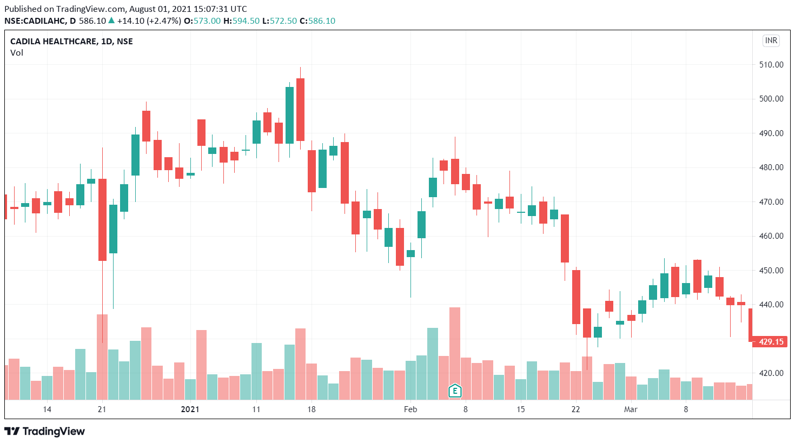

Bearish Engulfing
Period: 20Jan-22Jan 2021
A green candle on 20 Jan Followed by a red candle with bigger size than a previous green candle considered as a reversal trend for next trading day

Slide 17
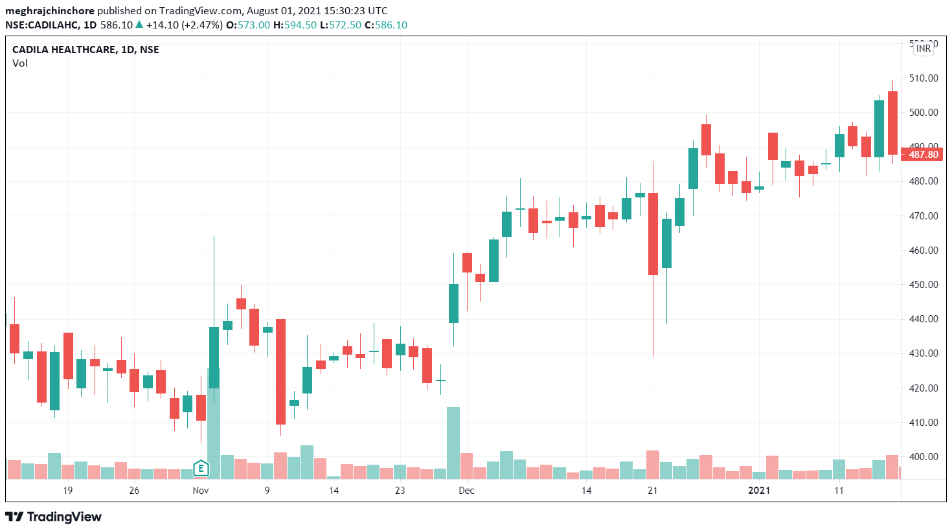
Doji star - Bearish
Period: 4Dec-6Dec 2020
A green candle on 4th Dec followed by a Doji opening above the body of previous candle considered as a reversal signal for next trading day

Slide 18
Technical Indicators
Relative Strength Index (RSI)
Money Flow Index (MFI)

Slide 19
Relative Strength Index (RSI)
The Relative Strength Index (RSI) is a Technical Indicator that uses Average price gains/ losses to assess the price momentum of a stock.
RSI value varies between 0-100.
Value above 70 indicates that stock was Overbought where value below 30 indicates that the stock was Oversold.
The RSI will rise as the number and size of positive closes increase, and it will fall as the number and size of losses increase.

Slide 20
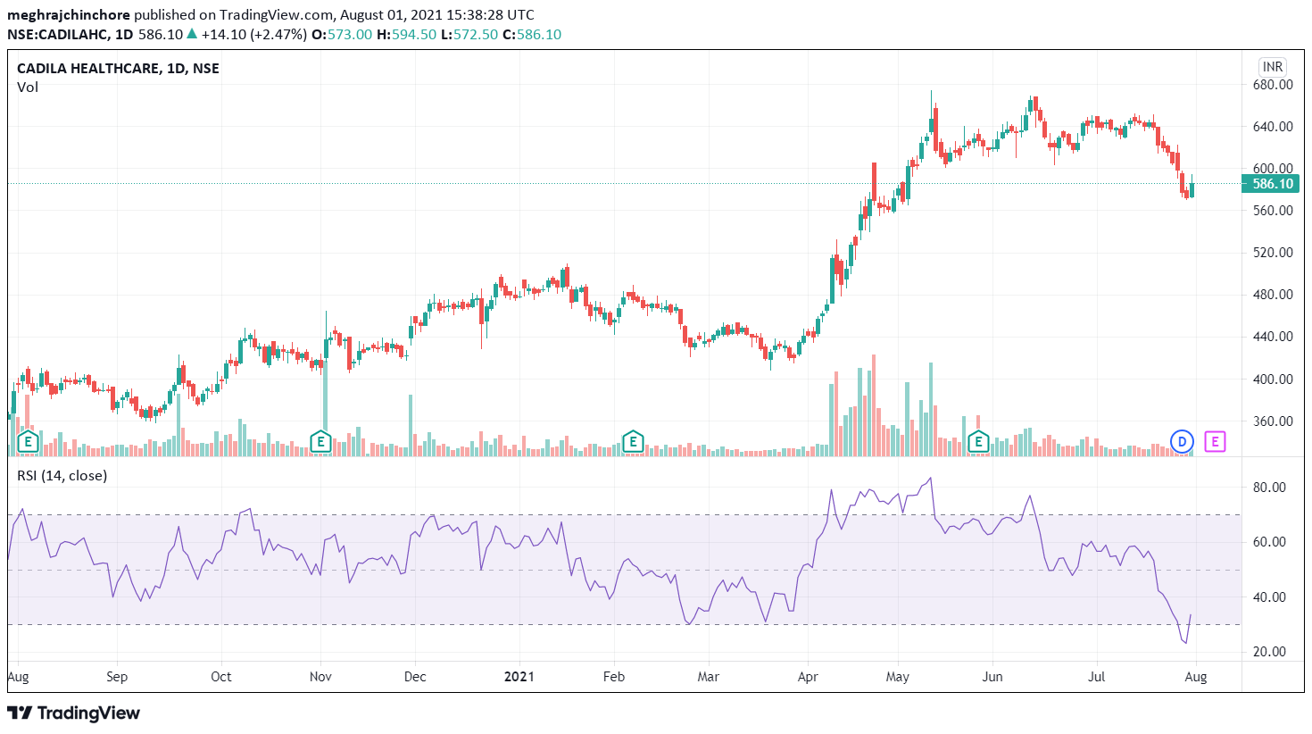
If we look at a Cadila Healthcare chart, mostly it’s stock price fluctuates between 30-70.
For a year, average RSI value of the stock is 33.54 which is mid-range.

Slide 21
Money Flow Index (MFI)
The Money Flow Index (MFI) is a technical oscillator that uses price and volume data for identifying overbought or oversold signals in an asset.
RSI value varies between 0-100.
Value above 80 indicates that stock was Overbought where value below 20 indicates that the stock was Oversold.
A divergence between the indicator and price is noteworthy.

Slide 22
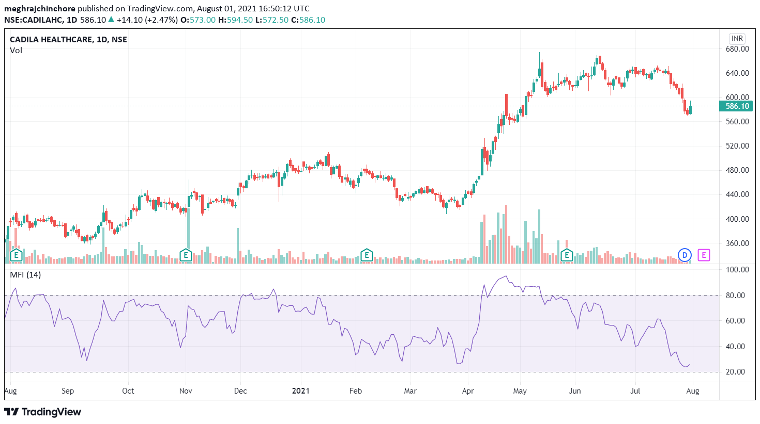
If we look at a Cadila Healthcare chart, mostly it’s stock price fluctuates between 20-80.
For a year, average MFI value of the stock is 25.6 which is mid-range.

Slide 23
Trendlyne Momentum Score
The Trendlyne Momentum Score combines over 20 key technical indicators to calculate the stock's technical strength in the market.
The momentum score is recalculated at the end of trading day between 5pm and 7pm on most days.
Stocks with score above 70 are considered as technically Strong and below 35 are considered weak.
The Trendlyne Momentum Score for the Cadila Healthcare stock is 52.3 which indicates that stock is technically neutral.

Slide 24
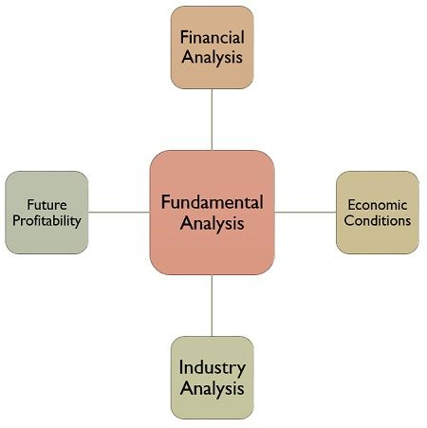
Technical Analysis Vs. Fundamental Analysis
Fundamental analysis and technical analysis, the major schools of thought when it comes to approaching the markets, are at opposite ends of the spectrum. Both methods are used for researching and forecasting future trends in stock prices, and like any investment strategy or philosophy, both have their advocates and adversaries.
Fundamental analysis is a method of evaluating securities by attempting to measure the intrinsic value of a stock. Fundamental analysts study everything from the overall economy and industry conditions to the financial condition and management of companies. Earnings, expenses, assets and liabilities are all important characteristics to fundamental analysts.

Slide 25
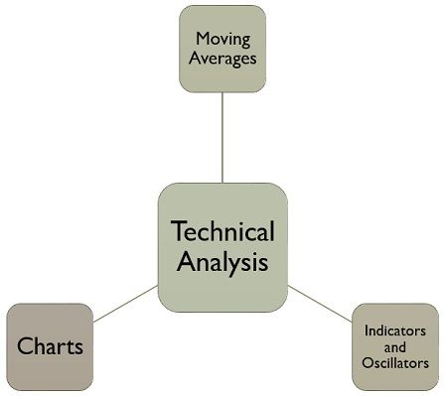
Technical analysis differs from fundamental analysis in that the stock's price and volume are the only inputs. The core assumption is that all known fundamentals are factored into price; thus, there is no need to pay close attention to them. Technical analysts do not attempt to measure a security's intrinsic value, but instead use stock charts to identify patterns and trends that suggest what a stock will do in the future.

Slide 26
Blending Technical and Fundamental Analysis
Some technical analysis methods combine well with fundamental analysis to provide additional information to investors. These include:
1)Volume Indicators: One of the most popular methods for gauging market sentiment is to take a look at the recently traded volume. Volume indicators are popular tools among traders because they can help confirm whether other investors agree with your perspective on a security. Traders generally watch for the volume to increase as an identified trend gains momentum.
2) Tracking Short-Term Movements: While many fundamental investors tend to focus on the long haul, the odds are that they still want to obtain a favorable buy-in price and/or a favorable selling price upon liquidating a position. Technical analysis can be handy in these situations as well.
A good trading strategy for a retail trader, from the above discussion, can be investing long term in a stock with good fundamentals and using technical analysis to predict the local dips and buying them in order to lower the average cost.

